Slide 1

DSAI 4201 – Selected Topics in Data Science
Dr. Uzair Ahmad

Slide 2
Lecture 8 (A)
Explainability of AI Models
Understanding, Interpreting, and Trusting AI Decisions
Dr. Uzair Ahmad

Slide 3
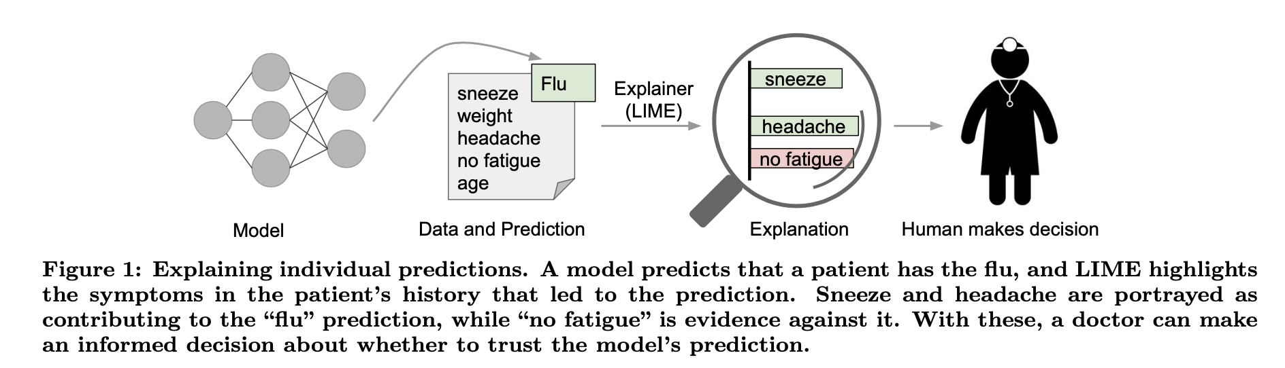
Introduction
Ribeiro et al “Why Should I Trust You?” Explaining the Predictions of Any Classifier. KDD 2016.

Slide 4
Introduction
AI models are becoming increasingly complex (e.g., deep learning).
Explainability is critical for trust, fairness, and regulatory compliance.
What Is Explainability?
Explainability = The ability to describe how and why an AI model makes a decision.
What is the difference between Explainability and Interpretability?
Interpretability → understanding a model’s logic
Explainability → describing the decision in human-understandable terms

Slide 5
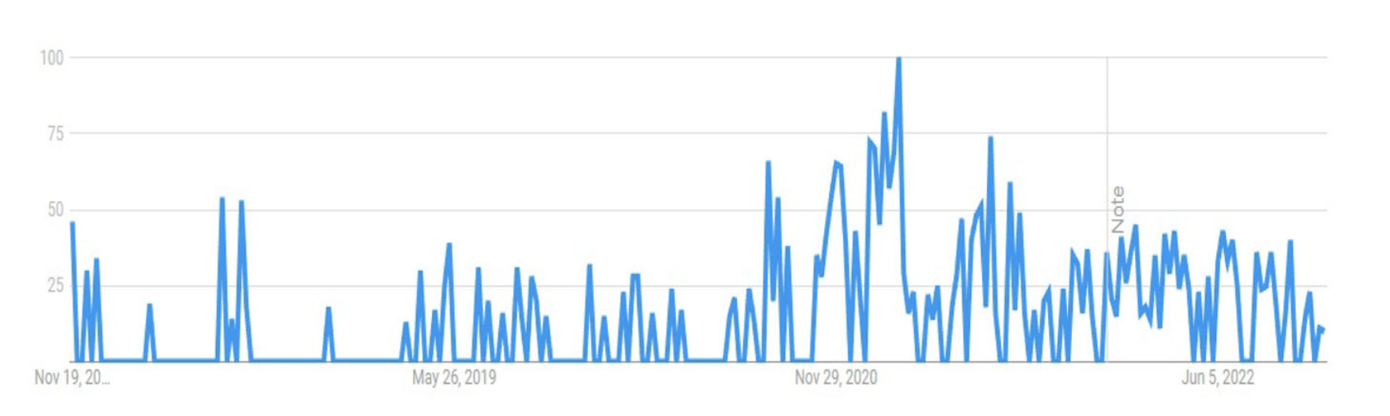
What is Explainable AI?
Who Needs Explainability?
End Users (e.g., medical doctors using AI for diagnosis).
Developers & Data Scientists (debugging models).
Regulators & Policymakers (ensuring fairness).
Business Leaders (AI-driven decision-making transparency).
Chinu and Bansal. Explainable AI: To Reveal the Logic of Black-Box Models. part of Springer Nature 2023.

Slide 6
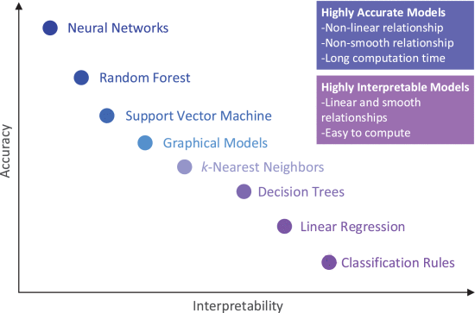
What is Explainable AI?
Morocho-Cayamcela et al. Machine Learning for 5G/B5G Mobile and Wireless Communications: Potential, Limitations, and Future Directions. IEEE Access 2019.

Slide 7
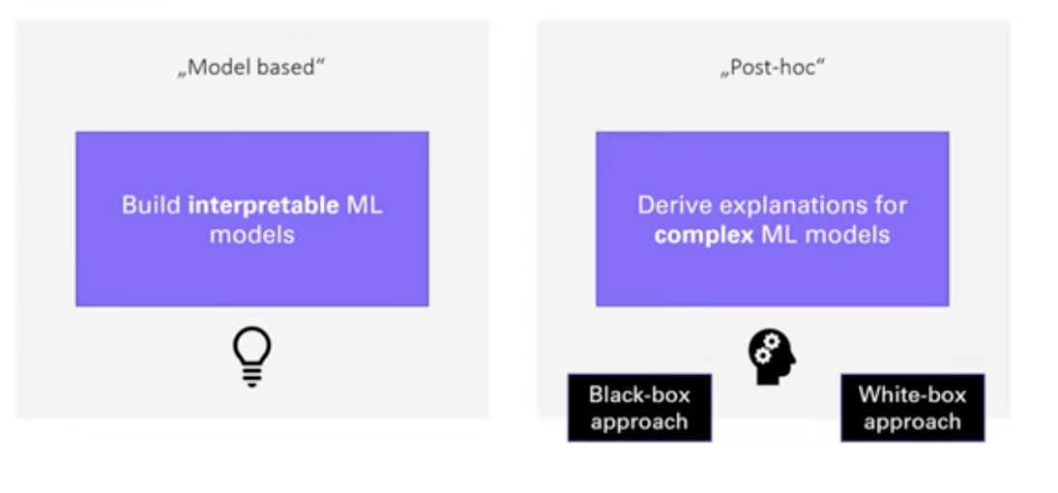
What is Explainable AI?
Understanding ML models

Slide 8
What is Explainable AI?
Model | Explainability
Linear Regression | High
Decision Trees | High
Random Forests | Medium
Deep Learning (DNNs) | Low
Transformers (e.g., GPT) | Very Low

Slide 9
Why Explainability matters?
Transparency and User Trust
Users need to understand AI decisions, especially in high-stakes scenarios like loan approvals or medical diagnoses.
Example: A customer wants to know why their loan application was rejected, or a patient seeks clarity on why an AI model suggests cancer-related medication.
Model Validation and Debugging
AI models can inherit biases from training data, leading to unfair and unethical decisions (e.g., gender bias in loan approvals).
Explainability helps validate models before deployment, ensuring compliance with legal and ethical standards.
AI explanations also assist in debugging errors and mitigating adversarial ML attacks, reducing incorrect decisions.
Notes:
Artificial Intelligence is playing an increasingly important role in decision-making across various industries—finance, healthcare, law enforcement, and beyond. However, as AI models become more complex, especially deep learning models, they often operate as black boxes, making decisions that are difficult to interpret or justify.
This lack of transparency raises critical concerns. How can we trust AI decisions if we don’t understand how they are made? How can businesses ensure their AI systems comply with ethical and legal standards, such as GDPR’s 'Right to Explanation'?
This is where Explainable AI, or XAI, becomes essential. XAI aims to provide insights into how AI models function, helping us identify bias, improve fairness, and increase user trust. It is particularly important in high-stakes environments. For example, a doctor needs to understand why an AI system recommends a specific treatment, or a loan applicant deserves to know why their request was denied.
By making AI more interpretable, we enable more accountable, ethical, and fair decision-making, ultimately fostering greater trust in AI-driven systems.

Slide 10
Why Explainability matters?
Knowledge Discovery and Counterfactual Explanations
XAI can extract hidden insights from model data and suggest actionable changes.
Example: If a loan application is rejected, counterfactual explanations might suggest improving the credit score to increase approval chances.
Optimized Model Performance
AI models perform better when bias is reduced, and decisions are fair, interpretable, and legally compliant.
Trustworthy explanations improve model reliability and robustness, ensuring AI adoption in critical sectors.

Slide 11
How to Make AI Models Explainable?
Types of explanations
Text-Based Explanations
AI-generated natural language descriptions that explain model decisions.
Useful for human-readable transparency, making AI outputs more interpretable.
Visual Explanations
Explanations represented as graphs, heatmaps, or charts, making AI decisions easier to understand for non-experts.
Example: Saliency maps in deep learning that highlight important regions in an image.
Numerical Explanations
Explanations expressed in mathematical or statistical terms, often used in scientific or technical AI applications.

Slide 12
How to Make AI Models Explainable?
Types of explanations
Example-Based Explanations
The AI system retrieves and presents similar instances from the training data to justify a decision.
Example: If an AI classifies a tumor as malignant, it shows similar past cases to support its decision.
Simplification-Based Explanations
Complex models are compared with simpler models (e.g., decision trees vs. deep learning) to evaluate accuracy trade-offs.
Helps users balance interpretability and performance.
Feature Relevance Explanations
Highlights which input features (variables) most influenced the AI decision. It highlights the ranking of important ratings. The higher score in ranking indicates a more important input variable.
Example: In credit scoring, income and credit history may have the highest feature importance scores.

Slide 13
How to Make AI Models Explainable?
Types of explanations
Local Explanations
Explainability for specific instances rather than the entire model.
Example: LIME (Local Interpretable Model-agnostic Explanations) explains why a single loan application was rejected.
Counterfactual Explanations
Instead of justifying why a decision was made, it answers: "What would need to change for a different outcome?”
Example: If a loan was denied, the system might suggest: "Your application would have been approved if your credit score was 50 points higher.”
Useful for understanding model decisions and offering actionable feedback.

Slide 14
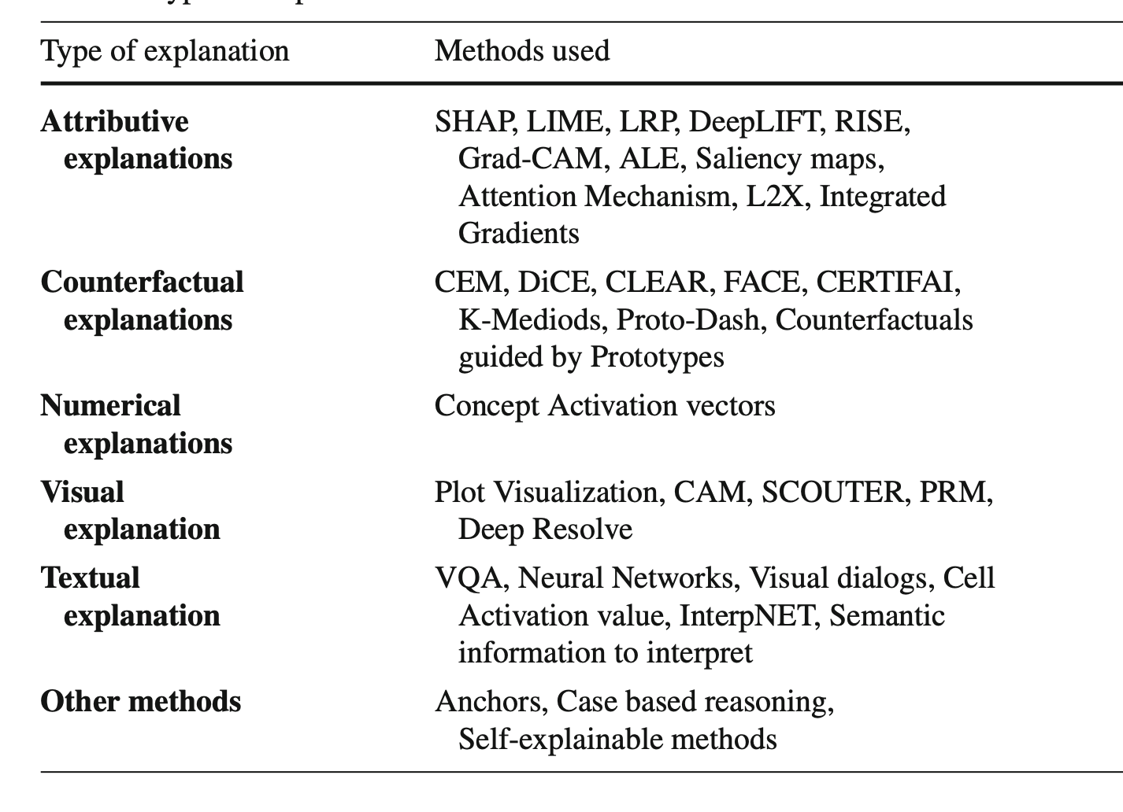
How to Make AI Models Explainable?
Types of explanations
Attributive explanations provide heatmaps and generate scores and
attention weights to explain the decision made by models. They
use text and image data as input.
Chinu and Bansal. Explainable AI: To Reveal the Logic of Black-Box Models. part of Springer Nature 2023.

Slide 15
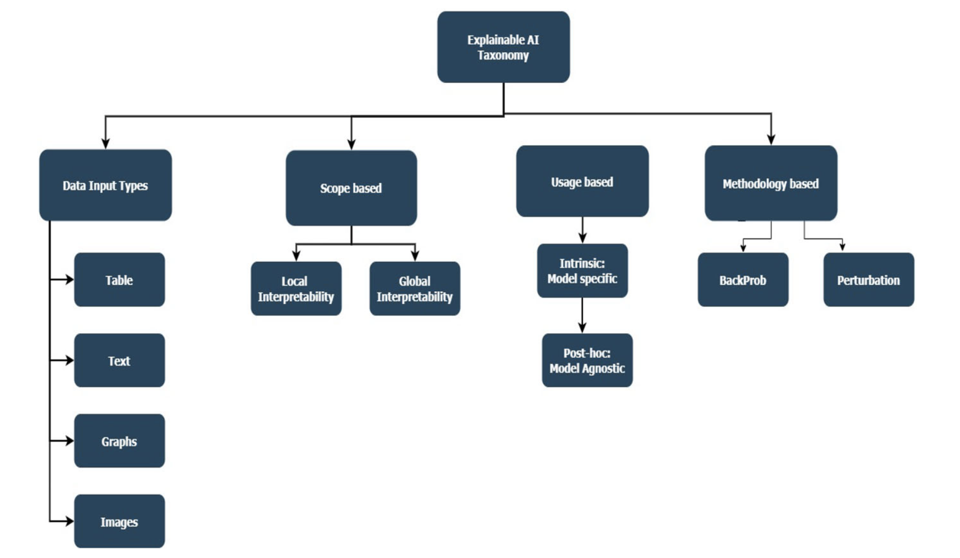
Taxonomy of Explainable AI?
Chinu and Bansal. Explainable AI: To Reveal the Logic of Black-Box Models. part of Springer Nature 2023.

Slide 16
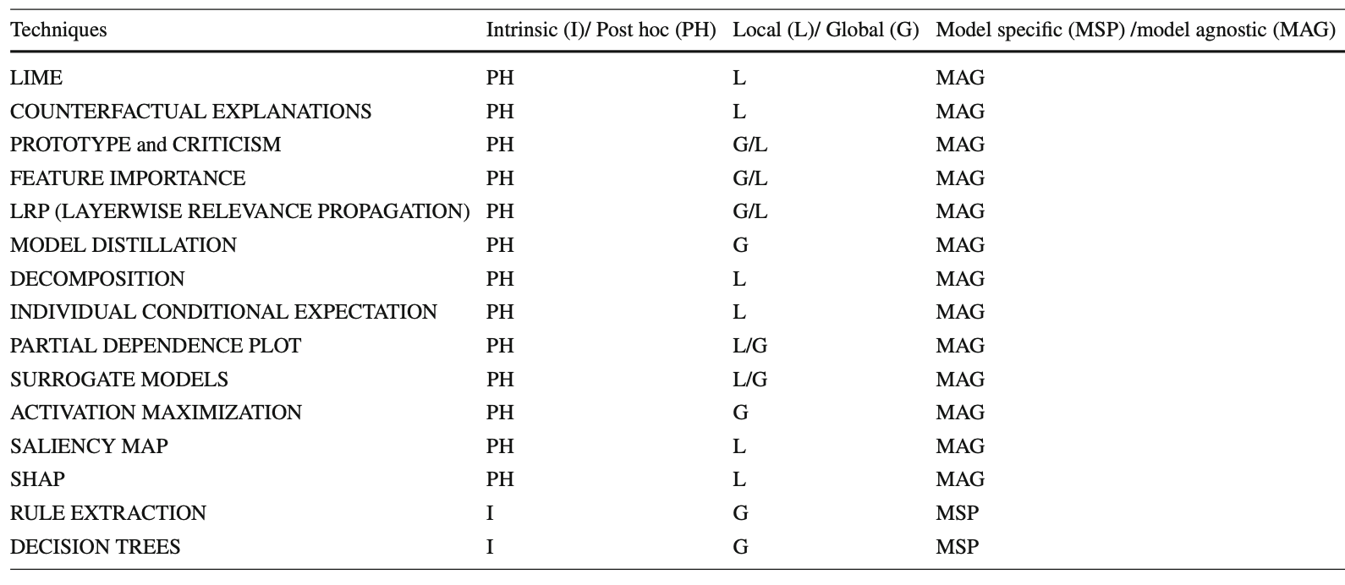
Techniques/Methods Used for Explainable AI
Chinu and Bansal. Explainable AI: To Reveal the Logic of Black-Box Models. part of Springer Nature 2023.

Slide 17
Model-Agnostic Explainability Techniques
LIME (Local Interpretable Model-Agnostic Explanations)
SHAP (SHapley Additive Explanations)
Chinu and Bansal. Explainable AI: To Reveal the Logic of Black-Box Models. part of Springer Nature 2023.

Slide 18
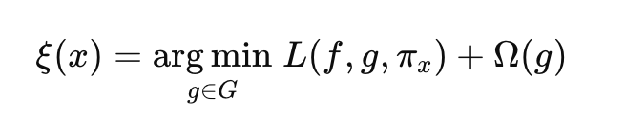
LIME (Local Interpretable Model-Agnostic Explanations)
Used to explain individual AI model predictions by approximating the complex model with a simpler, interpretable model (such as linear regression) in a local neighborhood of the prediction.
Is model-agnostic, meaning it can be applied to any machine learning model (e.g., deep learning, decision trees, support vector machines).
Good approximation
Stay simple
Objective function of LIME
Simpler interpretable model
Proximity
Complex
model
Family of interpretable models

Slide 19


Example: LIME on a credit scoring model
Income = $50,000
Consider an AI model predicting whether a loan application will be approved.
Credit Score = 720
Debt Ratio = 35%
$$x′$$
LIME will perturb these features (e.g., changing income to $55,000 or debt ratio to 30%) to generate nearby instances. The modifications introduce small random changes in the input while keeping it in the same neighborhood.
Then it gets model predictions on Perturbed Samples; The complex model predicts outputs for each sample $f\left(X^{′}\right).$
Fit a Simple, Interpretable Model (e.g., Linear Regression); Fit a weighted linear model $g$ to approximate the black-box model$f$ in the neighborhood of $x′$ . Assign higher weights to samples closer to $x′$.
Interpret the Model Explanation; The linear model coefficients represent feature importance, helping explain the original prediction.

Slide 20
Example: LIME on a credit scoring model
Income = $50,000
Consider an AI model predicting whether a loan application will be approved.
Credit Score = 720
Debt Ratio = 35%
LIME Explanation Output:
$$x′$$
Feature | Explainability
Credit Score | + 0.3 (high impact)
Income | + 0.2 (moderate impact)
Debt Ratio | - 0.5 (strong negative impact)
LIME reveals that a lower debt ratio would increase approval chances, providing a counterfactual explanation.
(If the applicant reduced their debt ratio, their chances of loan approval would increase)

Slide 21
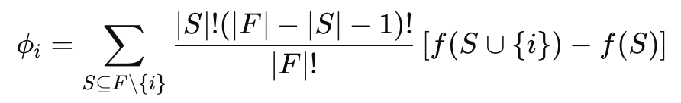


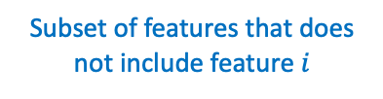

SHAP (SHapley Additive Explanations)
Is a game-theoretic approach to explain the output of machine learning models.
It is model-agnostic
It assigns a contribution score to each feature, indicating how much that feature influenced the model's prediction for a given instance.
Weighting factor
Prediction when $i \text{added} \text{to} S$
Shapely value formula
Shapely value (importance score) for feature $i$
Subset of features that does not include feature $i$
Prediction
u$sing only$
$$\text{features} \text{in} S$$
Full set of features

Slide 22
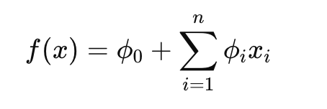
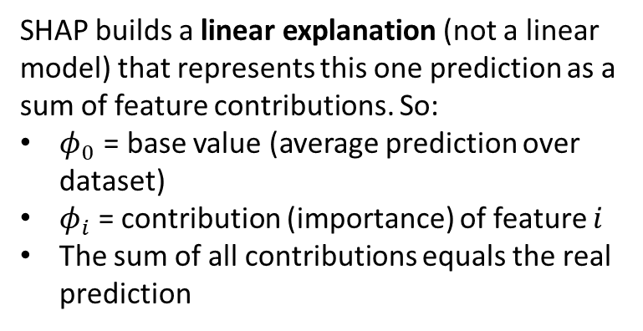

SHAP (SHapley Additive Explanations)
Compute the model output $f\left(x\right)$for the given instance.
Evaluate feature subsets by removing and adding features.
Contribution of feature $xi$
Base value (expected prediction if no features are used).
Calculate Shapley values using the contribution of each feature.
SHAP builds a linear explanation (not a linear model) that represents this one prediction as a sum of feature contributions. So:
$φ_{0}$ = base value (average prediction over dataset)
$φ_{i}$ = contribution (importance) of feature $i$
The sum of all contributions equals the real prediction
Sum feature contributions to reconstruct the original model output.

Slide 23
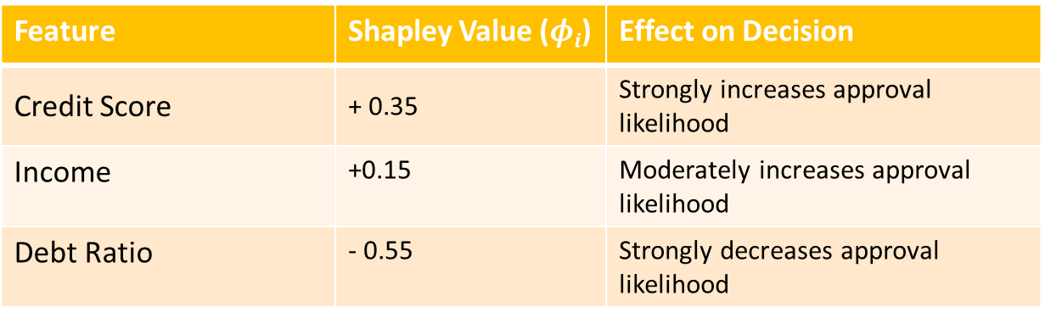
Example: SHAP on a credit scoring model
Income = $50,000
Consider an AI model predicting whether a loan application will be approved.
Credit Score = 720
Debt Ratio = 35%
LIME Explanation Output:
Feature | Shapley Value ($φi$​) | Effect on Decision
Credit Score | + 0.35 | Strongly increases approval likelihood
Income | +0.15 | Moderately increases approval likelihood
Debt Ratio | - 0.55 | Strongly decreases approval likelihood
SHAP reveals that (in addition to credit score) a higher income improves the applicant’s chance to get approved, but not enough to outweigh the high debt ratio.

Slide 24
Applications of Explainable AI
Finance & Banking
Loan Approval & Credit Scoring: XAI helps explain why a loan was approved or denied, ensuring fairness and compliance with regulations like GDPR and Fair Lending Act.
Fraud Detection: XAI helps financial institutions interpret anomalies in transactions to detect fraudulent activities.
Healthcare & Medicine
Medical Diagnosis: XAI ensures that decisions are interpretable, helping doctors validate AI recommendations.
Drug Discovery: XAI explains why certain chemical compounds are selected for new drug development.
Law & Policy
Judicial Decision Support: XAI ensures transparency so that legal professionals understand AI-generated legal recommendations.
Fair Hiring Practices: XAI ensures job applications are evaluated fairly, reducing bias.

Slide 25
Applications of Explainable AI
Autonomous Systems & Transportation
Self-Driving Cars: XAI explains why a vehicle took a particular action, improving safety and accountability.
Air Traffic Control: XAI provides clear explanations for better decision-making.
Cybersecurity & Fraud Detection
Threat Detection: XAI helps analysts understand why a particular activity is classified as a threat.
Phishing Detection: XAI clarifies how email patterns are classified as fraudulent, improving security awareness.
Retail & E-commerce
Personalized Recommendations: XAI ensures that recommendations are interpretable and privacy-friendly.
Dynamic Pricing: XAI explains why prices fluctuate, improving transparency.

Slide 26
Challenges of Explainable AI
Scalability Issues: Many explainability methods (like SHAP and LIME) require running the model multiple times to generate explanations, making them computationally expensive for large datasets and deep learning models.
Fairness and Bias in Explanations
AI explanations may themselves be biased if the underlying model is trained on biased data.
Some explainability methods tend to favor certain features over others, leading to misinterpretations.
Adversarial Robustness
AI explanations can be manipulated by adversarial attacks, making them unreliable.
Attackers can design adversarial examples that lead to misleading explanations.
Lack of Standardization
There is no universal framework to evaluate how "good" an explanation is.
Different explainability techniques may provide contradictory results, making it hard to decide which explanation is most trustworthy

Slide 27
Future Trends in Explainable AI
Interactive AI Explanations
Moving from static explanations to interactive, user-driven explanations where users can ask questions and receive personalized responses.
Example: A doctor using an AI-powered diagnostic tool can adjust parameters and explore how different medical factors influence predictions.
Human-in-the-Loop Explainability
AI explanations will become more collaborative, where humans and AI work together to refine explanations.
Example: A financial analyst reviewing AI-based loan approvals can modify feature weights to see how different factors affect the outcome.
Causal Explainability
Future AI models will focus on causality rather than correlation, answering why a decision was made instead of just providing post-hoc feature importance.
Example: Instead of saying "low credit score is a top factor for denial," a causal model could determine if improving credit score would guarantee approval.
Legal and Regulatory Evolution
Governments and regulatory bodies will introduce stricter explainability laws to hold AI models accountable.
AI companies will need to ensure that explanations align with legal and ethical guidelines.

